Slide 1
Automatically Acquiring a Semantic
Network of Related Concepts
Date: 2011/11/14
Source: Sean Szumlanski et. al (CIKM’10)
Advisor: Jia-ling, Koh
Speaker: Jiun Jia, Chiou

Slide 2
Outline
Introduction
Relational strength
Categorical relatedness
Disambiguate nouns
Evaluation
Conclusion

Slide 3
Introduction
Relationships between noun senses (concepts) in the WordNet ontology constitute a rich taxonomy of semantic similarity.
To understand the role of semantic relatedness, for example, the following sentences:
(1) The astronomer photographed the star.
(2) The paparazzi photographed the star.

Slide 4
Introduction
The semantic network relates not just words, but concepts.
This network could presumably be used as a kernel to infer quantitative relatedness scores, in the same way that WordNet has been used to derive semantic similarity scores between concepts.

Slide 5
Introduction
Motivation:
Automatically disambiguate nouns to their appropriate senses(i.e., concept).
Relatedness between nouns is discovered automatically from co-occurrence in Wikipedia texts.
Goal:
Construct a semantic network, nouns in Wikipedia are linked to their semantically related concept in the WordNet noun ontology.
Automatically disambiguate nouns in Wikipedia to their corresponding noun senses in WordNet:
sense similarity clustering
high degrees of inter-relatedness

Slide 6
The semantic network unfolds in three stages:
Measure the relational strength between nouns co-occurring in Wikipedia .
Use this quantitative measure to make categorical assertions about relatedness between nouns.
Disambiguate related nouns automatically, giving rise to a semantic network of related concepts.
Notes:
Co-occurrence of nouns is considered only as sentence-level co-occurrence, and only between noun stems
The results from considering co-occurrence at the sentence level, rather than adopting a smaller or variable sized window

Slide 7
Terminology
Target:
Any noun for which we would like to extract
relatedness data.
Ex: park
Co-Target:
Nouns co-occurring with a target.
Ex: tree、grass、soil

Slide 8
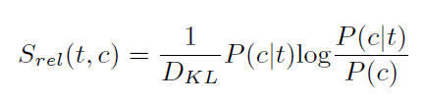
FROM CO-OCCURRENCE TO RELATIONAL STRENGTH
Relational strength:
P(c) is the relative frequency of c’s occurrence in the corpus
P(c|t) is the probability of encountering c in a sentence containing t
Notes:
P(c) is tthe number of times c occurs, divided by the number of noun tokens counted in the corpus)
P(c|t) is the number of times c occurs in sentences containing t,divided by the total number of nouns tokens co-occurring with t.

Slide 9
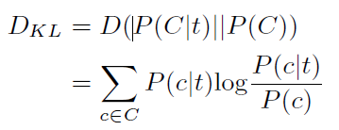
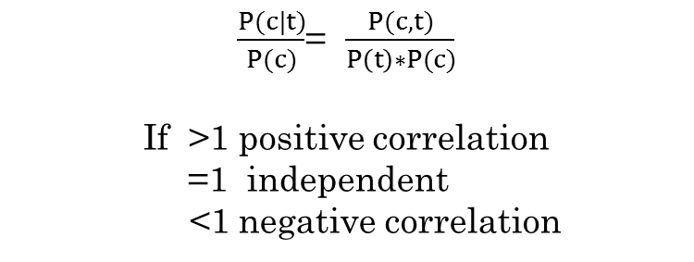
FROM CO-OCCURRENCE TO RELATIONAL STRENGTH
D_{KL} is Kullback-Leibler divergence:
$\frac{P(c|t)}{P(c)}$= $\frac{P(c,t)}{P\left(t\right)∗P(c)}$
If >1 positive correlation
=1 independent
<1 negative correlation

Slide 10
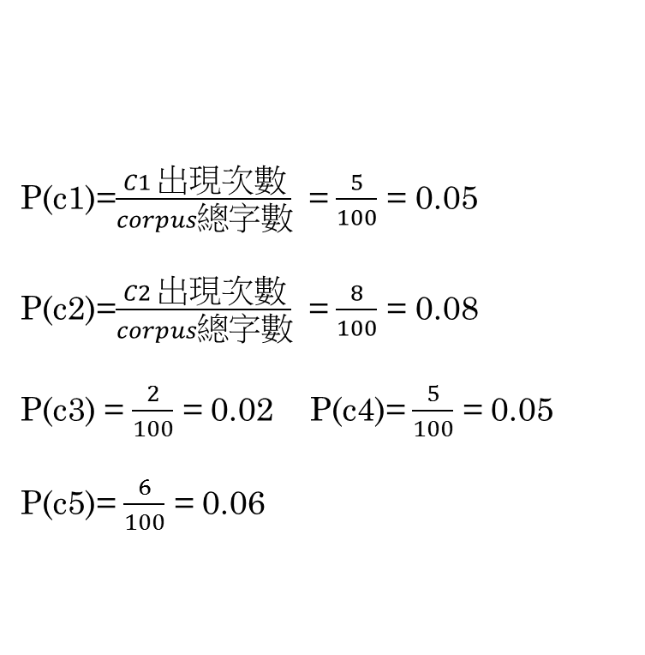
Corpus
-----------------------------------------------------------------------------------------------------------------------------------------------------------------------------------------------------------------------------------------------------------------------------------------------------------------------------------------------------------------------------------------
c1:5
c2:8
c3:2 total nouns:100
c4:4
c5:6
P(c1)=$\frac{C1 出現次數}{corpus總字數}$ = $\frac{5}{100}$ = 0.05
P(c2)=$\frac{C2 出現次數}{corpus總字數}$ = $\frac{8}{100}$ = 0.08
P(c3) = $\frac{2}{100}$ = 0.02 P(c4)= $\frac{5}{100}$ = 0.05
P(c5)= $\frac{6}{100}$ = 0.06
c1:5
c2:8
c3:2
c4:4
c5:6

Slide 11
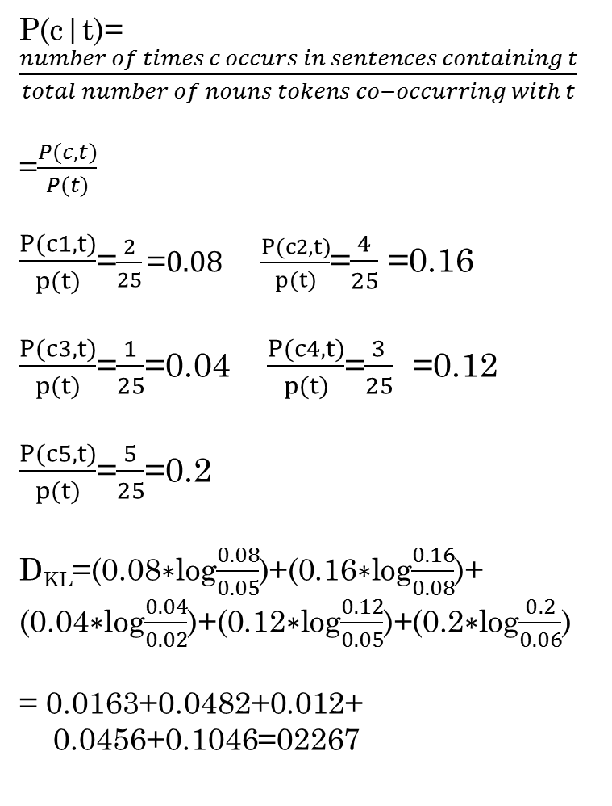
Co-target of target in sentences
P(c|t)=$\frac{number of times c occurs in sentences containing t}{total number of nouns tokens co−occurring with t}$
=$\frac{P(c,t)}{P(t)}$
$\frac{P(c1,t)}{p(t)}$=$\frac{2}{25}\text{=}0.08 \frac{P(c2,t)}{p(t)}$=$\frac{4}{25}$ =0.16
$\frac{P(c3,t)}{p(t)}$=$\frac{1}{25}$=0.04 $\frac{P(c4,t)}{p(t)}$=$\frac{3}{25}$ =0.12
$\frac{P(c5,t)}{p(t)}$=$\frac{5}{25}$=0.2
D_{KL}=(0.08$∗$log$\frac{0.08}{0.05}$)+(0.16$∗$log$\frac{0.16}{0.08}$)+
(0.04$∗$log$\frac{0.04}{0.02}$)+(0.12$∗$log$\frac{0.12}{0.05}$)+(0.2$∗$log$\frac{0.2}{0.06}$)
= 0.0163+0.0482+0.012+
0.0456+0.1046=02267
c1
2
c2
4
c3
1
c4
3
c5
5

Slide 12
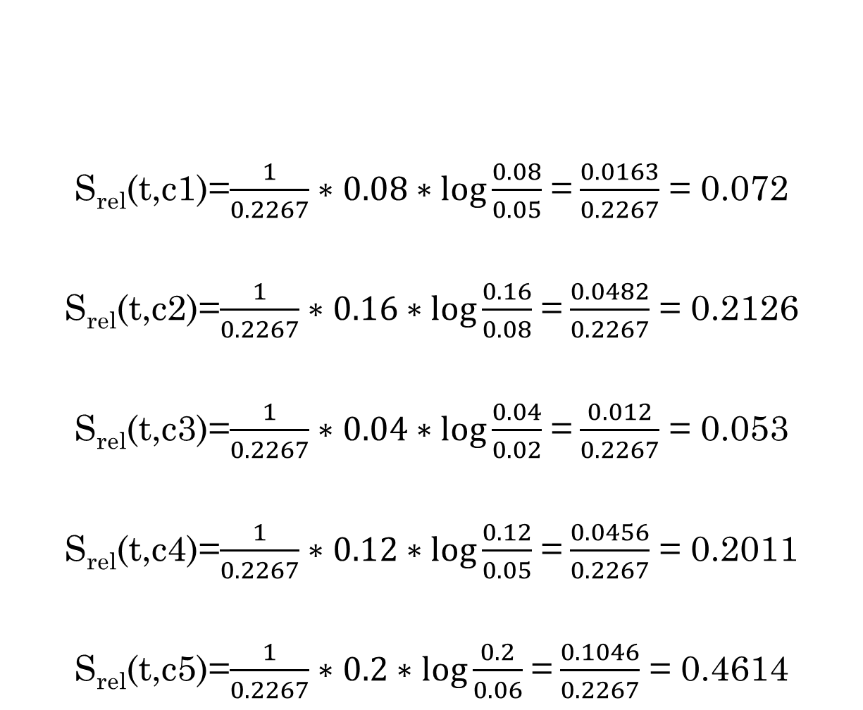
S_{rel}(t,c1)=$\frac{1}{0.2267}∗0.08∗log\frac{0.08}{0.05}$ =$\frac{0.0163}{0.2267}$ = 0.072
S_{rel}(t,c2)=$\frac{1}{0.2267}∗0.16∗log\frac{0.16}{0.08}$ =$\frac{0.0482}{0.2267}$ = 0.2126
S_{rel}(t,c3)=$\frac{1}{0.2267}∗0.04∗log\frac{0.04}{0.02}$ =$\frac{0.012}{0.2267}$ = 0.053
S_{rel}(t,c4)=$\frac{1}{0.2267}∗0.12∗log\frac{0.12}{0.05}$ =$\frac{0.0456}{0.2267}$ = 0.2011
S_{rel}(t,c5)=$\frac{1}{0.2267}∗0.2∗log\frac{0.2}{0.06}$ =$\frac{0.1046}{0.2267}$ = 0.4614

Slide 13
Target
0.072
0.053
0.4614
0.2126
0.2011
C1
C2
C3
C4
C5
其S_{rel}除上D_{kl}的用意是為了做正規化

Slide 14

FROM CO-OCCURRENCE TO RELATIONAL STRENGTH
We are primarily interested in using Srel(t, c) to measure the relatedness of t to c relative to all other co-targets of t, rather than measuring relational strength in a global fashion. D_{KL} is constant, So can be discarded:

Slide 15

FROM CO-OCCURRENCE TO RELATIONAL STRENGTH
This is particularly useful in suppressing words like “article,” which tends to appear frequently with nouns that serve as titles of Wikipedia articles, despite the fact that those nouns are not generally semantically related to “article” at all.
Notes:
This also protects us from false indications of relatedness that would arise if an incredibly rare word from the corpus were to co-occur with a semantically unrelated target just once or twice.

Slide 16
FROM RELATIONAL STRENGTH TO CATEGORICAL RELATEDNESS
To find related nouns:
Notion of mutual relatedness
Defined:
m_{x}(t)[ The set of all nouns mutually related to t
within x%]:
if c is in the top x% of t’s most strongly related co-
targets (sorted by S_{rel}),and t is in the top x% of c’s
most strongly related co-targets, we say that t
and c are mutually related within x%.

Slide 17
FROM RELATIONAL STRENGTH TO CATEGORICAL RELATEDNESS
Process (find related nouns):
To find the nouns categorically related to a target, t, we let x = 20 and find the initial set, m_{x}(t).
Then expand this set by incrementing x until 5 iterations pass without t being related to any additional co-targets.

Slide 18
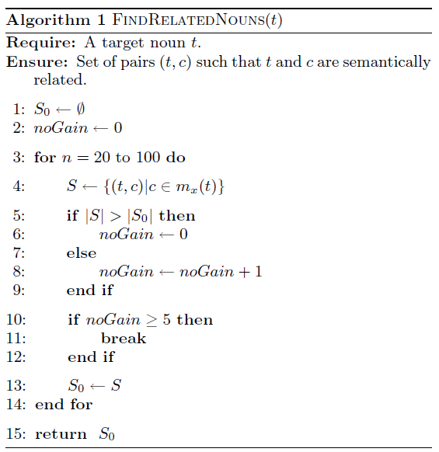

Slide 19
The method exhibits important properties :
This gradation makes it impossible even for human judges to find a clear cutoff
Stringent requirement causes us to miss some related noun pairs.
Ex: “penguin” and “iceberg”
“penguin” and “ice”
“penguin to ice” “ice to penguin”
Notes:
“penguin” and “iceberg”
strongly related in both directions
“penguin to ice” “ice to penguin”
far more strongly related in one direction

Slide 20
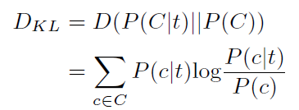

FROM NOUNS TO CONCEPTS
Disambiguate the nouns(3 method):
Subsumption Method
Gloss Method
Selectional Preference Method
selectional association A(t,c):
C is the set of concepts in WordNet denoted by the monosemous nouns that are related to t
Notes:
3. Selectional Preference Method:
This method sometimes assigns disproportionately strong selective power to hypernyms that are particularly rare in the prior distribution. As such, this method defers to the subsumption and gloss methods when its results conflict with theirs.

Slide 21
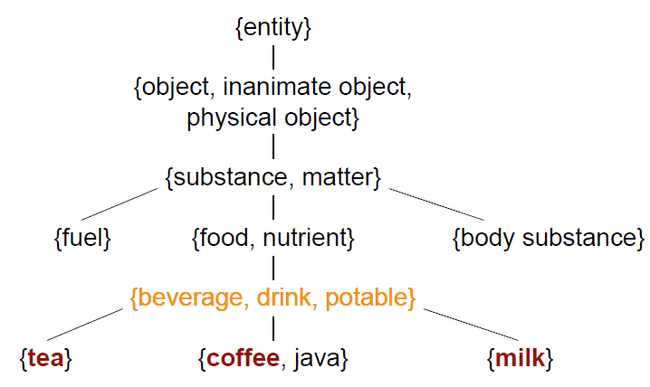
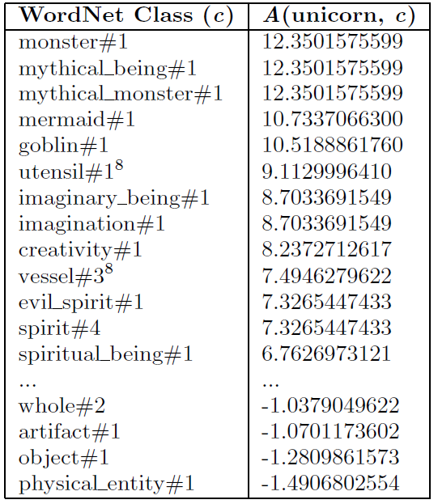

Slide 22
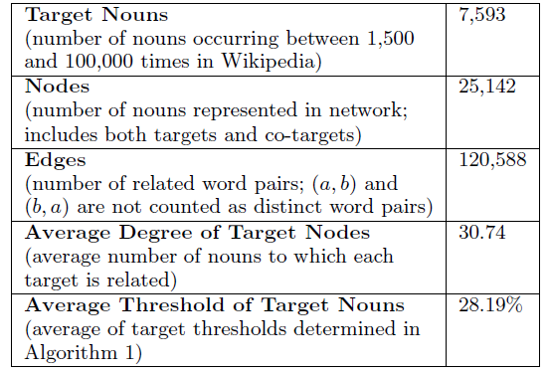
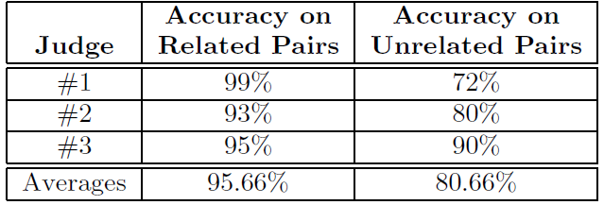

Summary of Statistics for the Semantic Network of Related Nouns
Judges’ Evaluations of Accuracy on Related
and Unrelated Noun Pairs

Slide 23
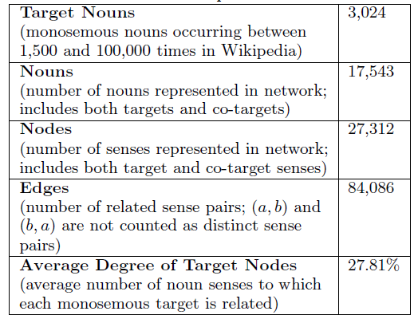
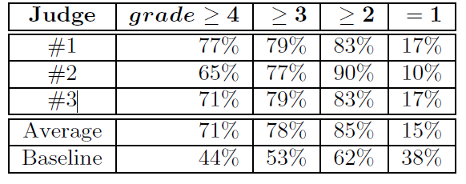
Summary of Statistics for the Semantic
Network of Related Concepts
(4) Primary intended sense or one of its synonyms.
(3) Strongly related sense, but not the primary intended
meaning.
(2) Weakly related sense; could reasonably be included or
excluded from relation to the target.
(1) Unrelated sense.
The judges were asked to grade the relation of each sense to its monosemous target, using the following scale:

Slide 24
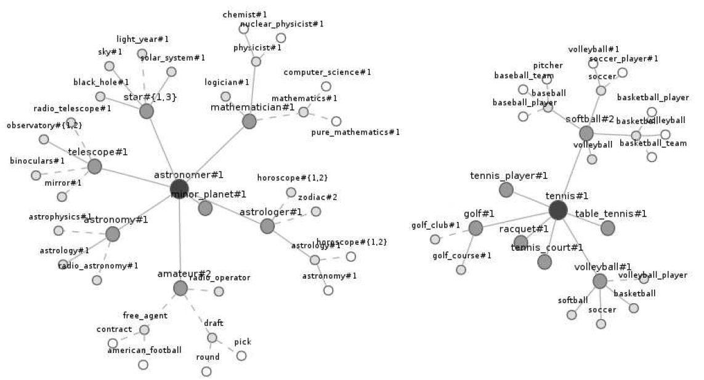
DISCUSSION

Slide 25
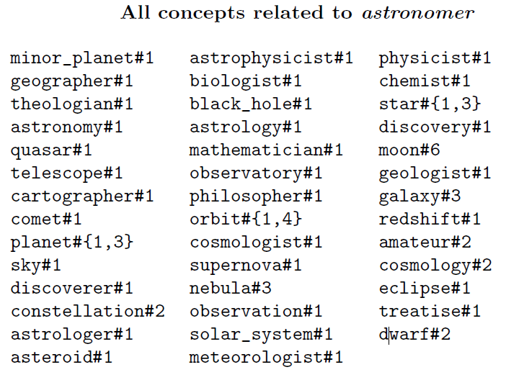

Slide 26
conclusion
There are several potential applications for this resource, including semantic interpretation ,noun sense disambiguation in multimedia content delivery systems.
In future work, they expect to continue expanding and refining the semantic network.
the feasibility of applying their algorithm to these targets and using the existing semantic network to guide the process, which is more error prone with nouns that occur infrequently in the corpus and does not currently resolve ambiguity of polysemous-to-polysemous noun relations.

Slide 27
Thank you
for your listening !

